Slide 1
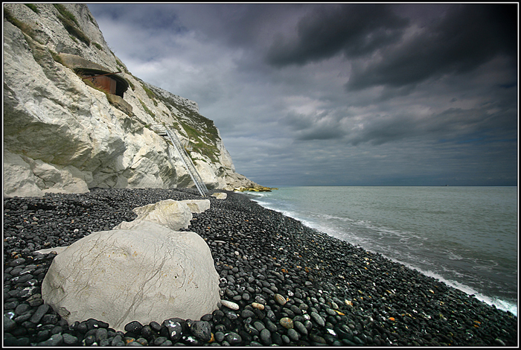
Dover Beach
Matthew Arnold

Slide 2
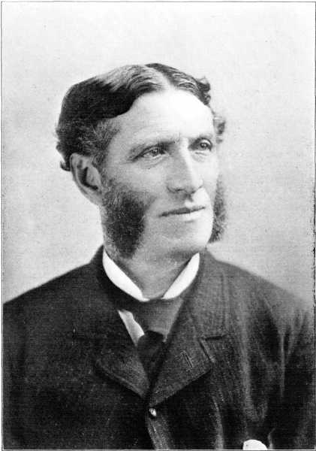
Background
Matthew Arnold seems to have written this around 1849-51. Arnold honeymooned in Dover in 1851 and may even have been working on this at the time.
The poem is set on Dover beach which is in the county of Kent by the English Channel facing the French port of Calais.
The idea of the honeymoon runs through the poem as well as of living in a time when religion was being eroded because of the new ideas of ‘Darwinism’ and evolution. For the first time the idea that there is a God was being seriously undermined and the feelings of doubt, of uncertainty, of the world becoming a dark place is very apparent in this poem.
What would life be like if there was no God?

Slide 3
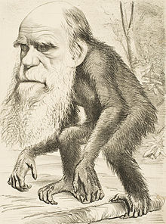
Darwanism and Evolution
Charles Robert Darwin (12 February 1809 – 19 April 1882) was an English naturalist .He established that all species of life have descended over time from common ancestry, and proposed the scientific theory that this branching pattern of evolution resulted from a process that he called natural selection.
The Church of England's response was mixed. Liberal clergymen interpreted natural selection as an instrument of God's design. However many church authorities regarded it as heresy.
Darwin was surrounded by the influence of the Church his entire life. He trained to be a clergyman and married into a staunch Anglican family. Despite this Darwin showed his human side by slowly losing his personal Christian faith, the erosion made complete by a need for evidence and no doubt the sad death of a beloved daughter .

Slide 4
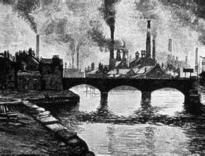
England During 1860’s
Victorian England
The Victorian Age brought about a new civilization. A civilization based upon industry, time, and money. Its values brought about a change in British life that was hard to cope with.
The conflicting ideas of religion and science, work and education, and simply living on impulse without a chance of reflecting upon actions, invoked the state of confusion which is associated with its time.
Matthew Arnold observed the plight of the Victorian Age, and sought an answer to the problems which he and his country were faced with.
In 1866, the Great Austro-Prussian war took place where Austria and Prussia went to was against each other. Arnold makes some references to war in his poem. Prussia the less powerful state defeated Austria in less than six months.

Slide 5
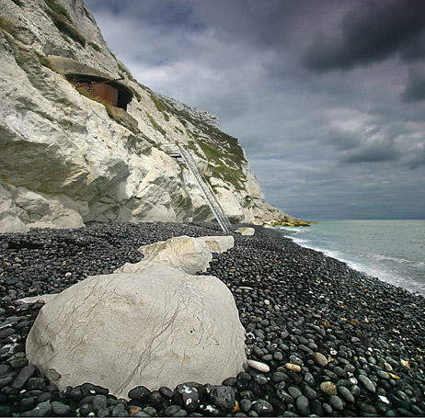
Tone
A melancholic poem
Pathetic fallacy is used to emphasise the feeling of the sadness of man with the use of the light of the moon and the description of the sea.
Throughout the poem the sea is used as an image and a metaphor. At first it is beautiful, later creates a hostile roar and then it evokes a feeling of sadness.

Slide 6
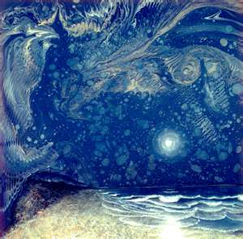
Stanza 1
The sea is calm tonight, The tide is full, the moon lies fair Upon the straits; on the French coast the light Gleams and is gone; the cliffs of England stand, Glimmering and vast, out in the tranquil bay. Come to the window, sweet is the night air!

Slide 7
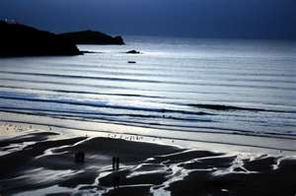
Stanza 1
Arnold creates a sense of security:
The sea between the straits
The French and the English coasts
The window which the speaker looks framing the scene
The use of the adjectives calm, fair, tranquil, sweet add to this mood
The speaker:
The speaker stands at the window looking out to sea before they possibly go to bed and is addressing his beloved in a romantic gesture to enjoy the tranquil scene from the window Come to the window, sweet is the night air!
The light
The light blinking on and off could be foreshadowing the message of later lines that the light of faith in God and religion, once strong, now flickers. on the French coast the light gleams and is gone. The reference to the cliffs could also symbolise the erosion of faith.

Slide 8
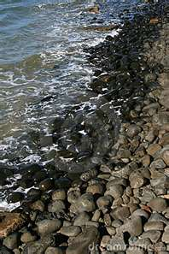
Stanza 2
Only, from the long line of spray Where the sea meets the moon-blanched land, Listen! you hear the grating roar Of pebbles which the waves draw back, and fling, At their return, up the high strand, Begin, and cease, and then again begin, With tremulous cadence slow, and bring The eternal note of sadness in.

Slide 9
Stanza 2
Use of sounds
The use of sound breaks the silent peaceful mood of contemplation and stability in stanza one.
The speaker dramatizes the crashing waves on the beach Listen! you hear the grating roar Of pebbles which the waves draw back, and fling
He focuses on the repetition of these sounds, the sea drawing back and roaring again to reflect the growing sadness and negativity The eternal note of sadness in. That whatever the result of change the world will be a more miserable place.
Use of onomat0poeia and hyperbole
grating roar introduces the idea of conflict between land and sea as well as symbolically the conflict between long-held religious beliefs

Slide 10
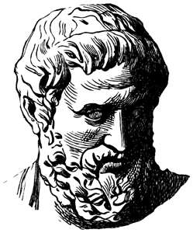
Stanza 3
Sophocles long ago Heard it on the Aegean, and it brought Into his mind the turbid ebb and flow Of human misery; we Find also in the sound a thought, Hearing it by this distant northern sea.

Slide 11
Stanza 3
Reference to Sophocles ( Greek playwright who wrote tragedies)
Arnold alludes to a part of the Greek play “Antigone” by Sophocles where he says that the gods can visit ruin on people from one generation to the next, like a swelling tide driven by winds.
In the sound of the sea, Arnold hears a thought that disturbs him just as Sophocles was disturbed by a sound in the Aegean. Sophocles long ago Heard it on the Aegean / Find also in the sound a thought,
Use of metaphor
the turbid ebb and flow / Of human misery is a metaphor to compare human misery to the sea. Like the tides of the sea, it comes and goes .

Slide 12
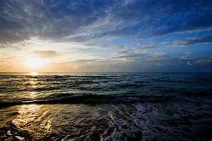
Stanza 4
The Sea of Faith Was once, too, at the full, and round earth's shore Lay like the folds of a bright girdle furled. But now I only hear Its melancholy, long, withdrawing roar, Retreating, to the breath Of the night wind, down the vast edges drear And naked shingles of the world

Slide 13
Stanza 4
Poetic Devices – Use of simile and metaphor
The Sea of Faith - comparison of faith to water making up an ocean.
Lay like the folds of a bright girdle furled - use of like to compare the sea to a girdle ( a piece of clothing to hold a woman’s waist in) The girdle symbolises a sense of protection, now the sea has withdrawn, the land and beaches are left unprotected. And naked shingles of the world
Religious Message
There was a time when faith in God was strong and comforting. This faith protected and comforted people just as the sea protects and wraps itself around the islands and the continents.
However now the sea of faith has become a sea of doubt. Science challenges theology and religion causing people to feel miserable, lonely and despairing. As a result people put their faith in material objects.

Slide 14
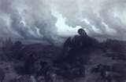
Stanza 5
Ah, love, let us be true To one another! for the world, which seems To lie before us like a land of dreams, So various, so beautiful, so new, Hath really neither joy, nor love, nor light, Nor certitude, nor peace, nor help for pain; And we are here as on a darkling plain Swept with confused alarms of struggle and flight, Where ignorant armies clash by night.

Slide 15
Stanza 5
The speaker and his remedy
The speaker again addresses his beloved as in stanza one and offers the only cure for this loss of faith Ah, love, let us be true / To one another! The only remaining solution is to true to those you love and have moral standards.
The speaker is being quite limited through this notion as he is openly seeking isolation from the world. He is rejecting the world and what it has to offer as a sham and a dreamland which can offer us nothing. To lie before us like a land of dreams, So various, so beautiful, so new, Hath really neither joy, nor love, nor light,
Use of language techniques
The use of simile to compare the world like a land of dreams,
The use of Anaphora (repetition of so) So various, so beautiful, so new,
The use of Anapora (repetition of nor) Hath really neither joy, nor love, nor light,
Final Message
Challenges to the long-standing moral and religious beliefs have shaken the faith of people in God and religion
Consequently the existence of God was in doubt.
Arnold who was deeply religious lamented the dying of the light of faith as shown in stanza one.

Slide 16
Structure
It is a lyric poem
There is no rigid rhyme scheme or structure.
Each stanza can be seen as separate incomplete sonnets
A loose rhyme scheme mirroring the basic iambic rhyme e.g. the first stanza reflects the movement of the sea.

